Slide 1
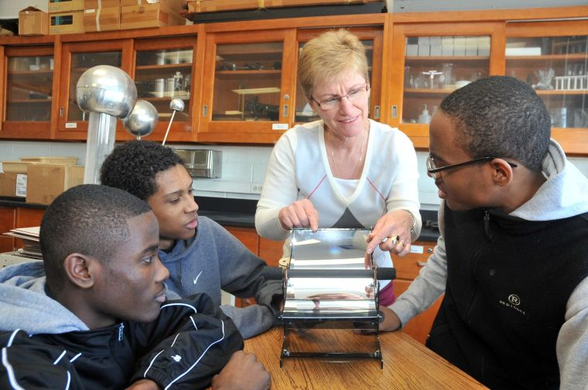
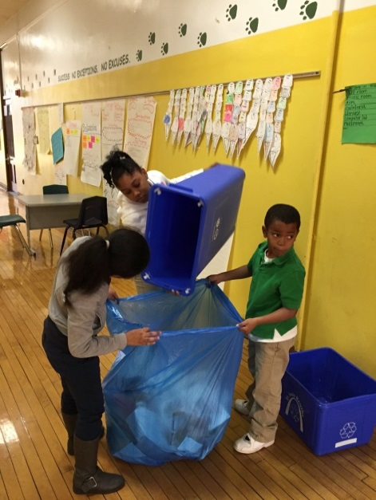
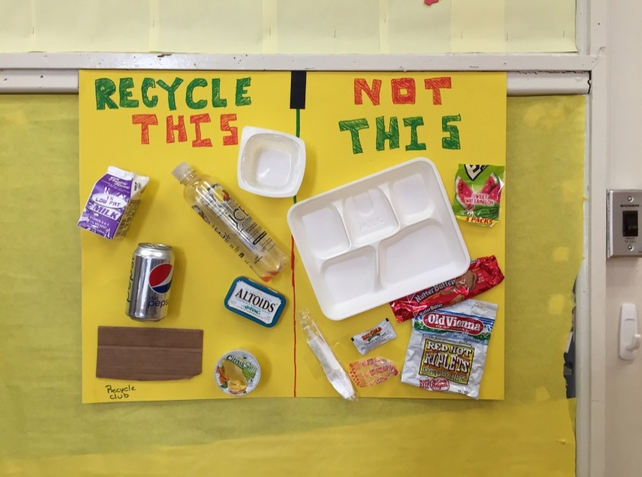
I Go Green SLPS Challenge Pilot Program
Promoting Energy and Resource Conservation Awareness

Slide 2
I Go Green SLPS Challenge Pilot Program
Overview
The I Go Green SLPS Challenge is a voluntary, year-long competition that educates students and staff to reduce their energy and water costs by implementing no-cost behavioral changes at their schools.

Slide 3
I Go Green SLPS Challenge Pilot Program
I Go Green SLPS Challenge Pilot Program
Mission Statement
Through hands-on, project-based STEM learning, the I Go Green SLPS Challenge seeks to encourage students and staff to:
Reduce consumption and cost
Stop the wasting of resources, and
Become better stewards of our environment
This challenge promotes district-wide involvement and ownership in the sustainability of their schools, homes and communities, as well as create future leaders in the green economy.

Slide 4
I Go Green SLPS Challenge Projects (50 Possible Points)
Stage 1 | Stage 2 | Stage 3 | Stage 4 | Stage 5
Gearing Up! | Student-Driven Energy + Water Assessment | Energy | Water | Gardens + Earth Day
Completed by Oct. 23 | Completed by Nov. 18 | Completed by March 18 | Completed by March 18 | Completed by May 11
Points are earned through a variety of challenges and other opportunities. For example, a school could earn points for powering down before spring break, planting a garden at the school or hosting an assembly to teach students best practices for recycling. Detailed information will be emailed to you.

Slide 5
Forming the School Green Teams
Students who serve on their school’s Green Teams will:
Hold leadership roles
Be trained on basic data collection equipment
Analyze, interpret and graph collected data
Raise awareness about sustainability to their school community
Patrol and issue Thank You and Oops tickets to promote energy cost reduction
Turn off unused or unnecessary classroom lights
Turn off running faucets and report leaks to the custodian
Report energy-saving methods
Audit recycling process and educate students /staff on best-practices

Slide 6
Green School vs. Sustainability Coordinators
Green School Coordinators are volunteers or mentors.
Their role is to:
Assist teaching staff with the I Go Green Challenge Pilot
Communicate about resources, events and due dates
Help facilitate projects and activities with students
Train the student Green Team to conduct sustainability patrols (Thank You and Oops tickets)
Coordinate parent sustainability workshops with school PTO and staff

Slide 7
Green School vs. Sustainability Coordinators
Sustainability Coordinators are teachers or school staff.
Their role is to:
Provide space and other in-kind resources to support the Green Team
Recruit student green team members and encourage participation
Work to include the use of I Go Green Challenge lessons in all teachers classes and/or afterschool programs
Submit project reports based on the submission timeline for each stage

Slide 8
Questions?
Contact Information
Lisa G. Williams, C.E.M Energy Manager
Saint Louis Public Schools – Aramark K-12 Education 3416 Cook Avenue St. Louis, MO 63106 Cell: (314) 215-7324

